Slide 1
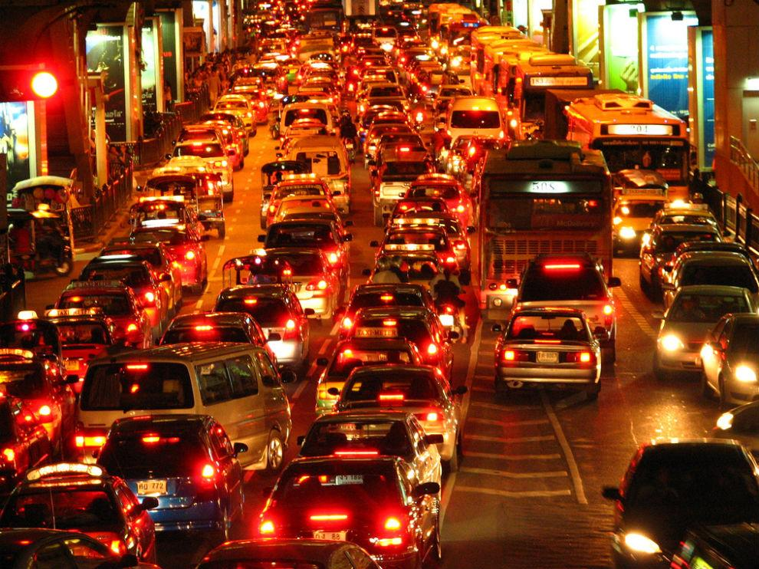
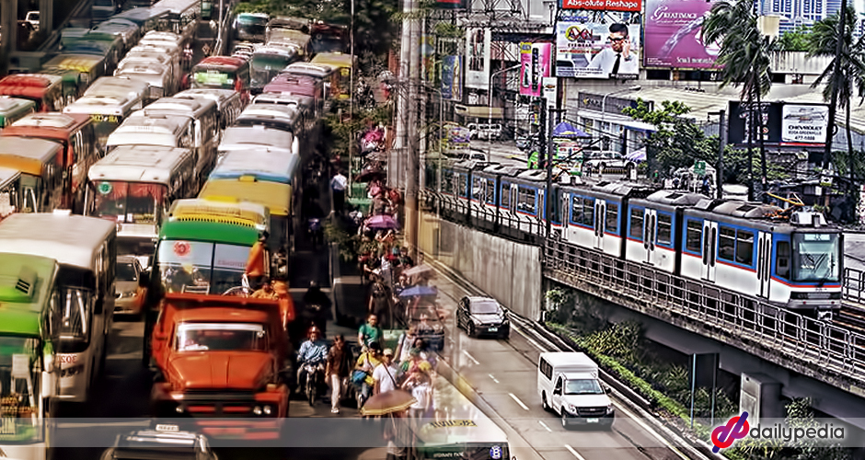
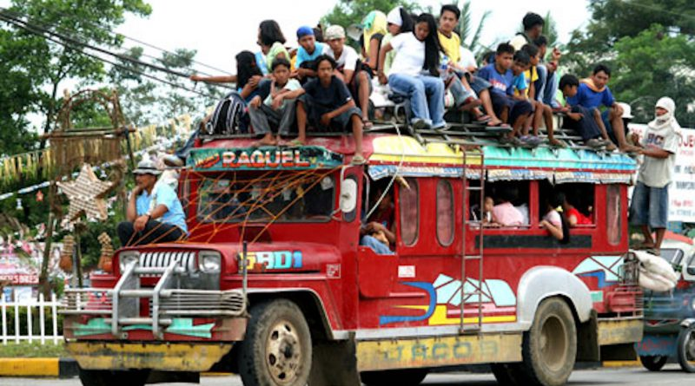
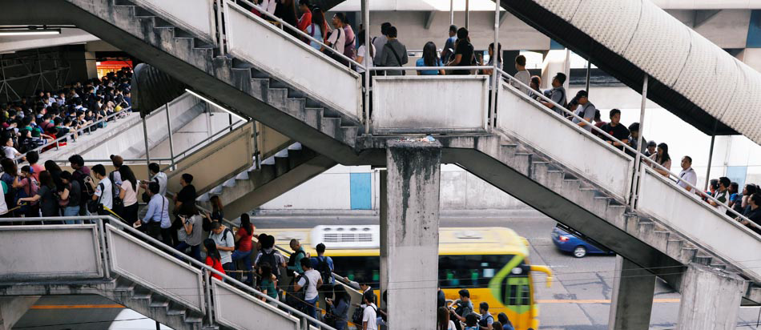
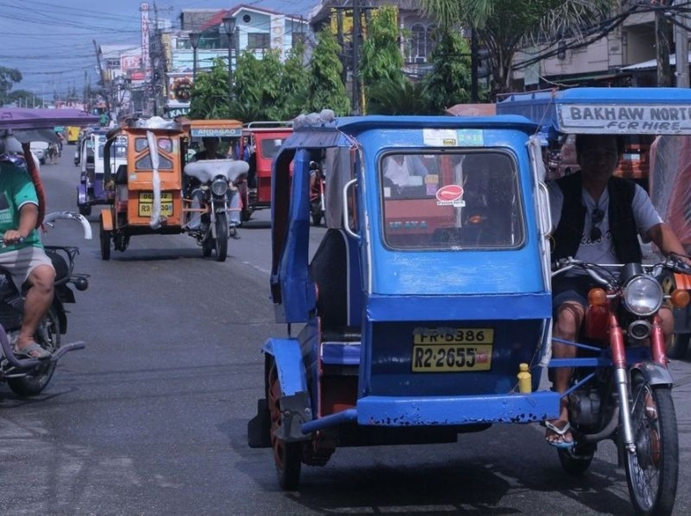
Notes:
One thing we surely don’t miss while we are in a community quarantine… communiting in a country with a poor public transportation system.
Due to the current state of our public transportation system, many of us try to find alternatives such as booking through ride sharing apps like Grab

Slide 2
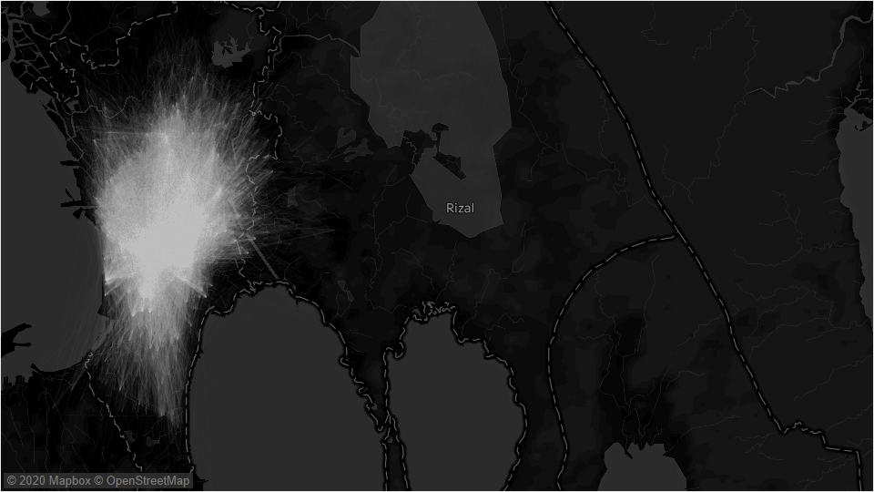

920M km
Traveled in PH
70% faster
Reduction in Travel Time
₱7,000
Average annual spending for 2018
600,000
Transaction per day
60,000
Partner Drivers
Source: https://www.grab.com/ph/
Notes:
Grab offers a much safer and more efficient way to commute.
In 2018 alone, the cumulative distance traveled by Grab reached around 900 m kilometers.
On the average, customers spend 7000 per year. But for heavy users, it can reach 6x that amount.
Grab receives thousands of requests a day, but with their limited partner drivers, they experience undersupply of vehicles-to-passengers.
Hence, one thing is for sure, you experience the same frustration with me when you to try to book for a Grab ride, even with multiple attempts, to no avail.

Slide 3
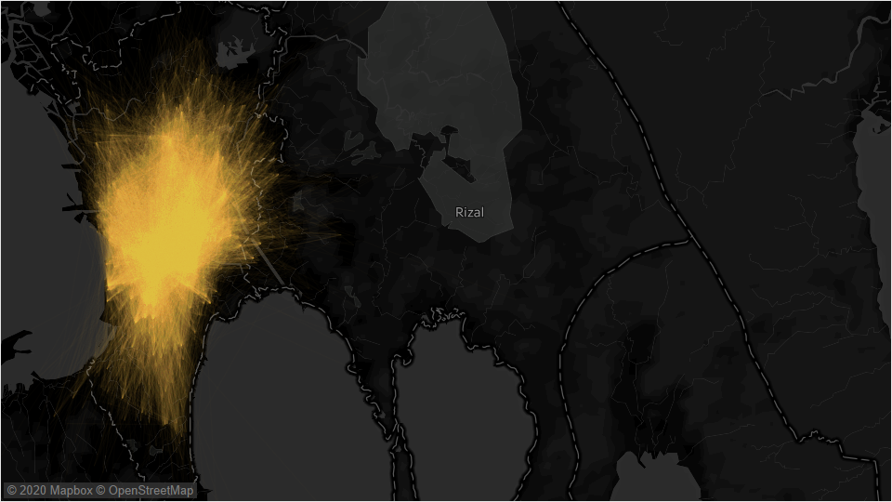
PREDICTING GRAB TAXI allocation Presented by: Jasper Kristian pangan
Notes:
Thus, I present to you my study, predicting grab booking allocation where I aim to predict if a booking will be allocated to a driver or not.

Slide 4

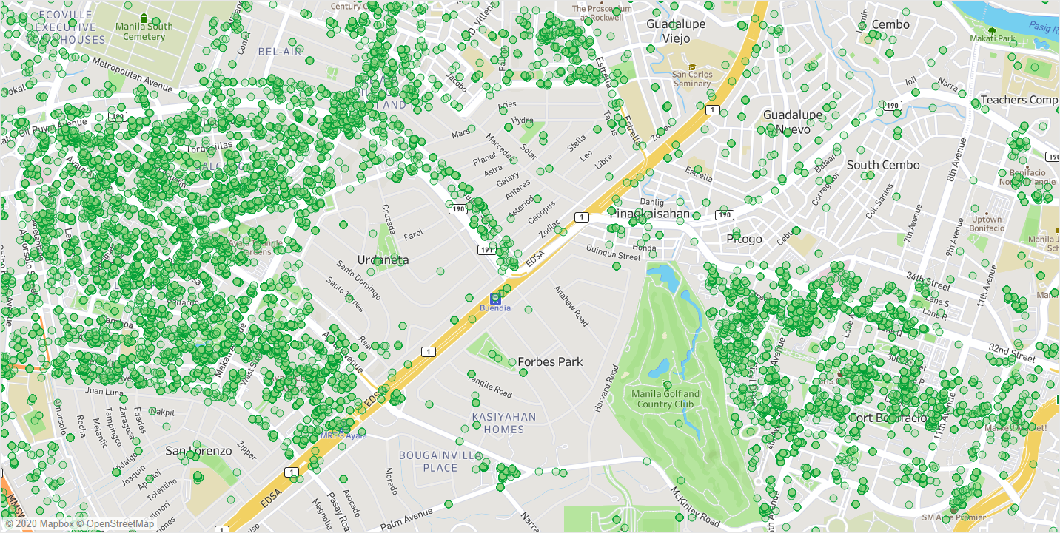

THE grab DATASET
194,976 booking transactions from
August 8 to December 20 2013 which are
tagged whether unallocated or allocated
Dataset Features
- date and time of the booking
- pick-up and drop-off latitude and longitude
Feature Extraction
performed reverse geocode and
geohashing with precision = 5
estimated trip distance using Manhattan distance
Notes:
First of, the Grab Dataset consists of grab taxi bookings from August to December 2013.
Each booking is tagged whether it is allocated or not
For the features, the date and time of booking is available. As well as pick-up and drop off location
Fare and Pickup distance is also available but I dropped them since these features are not available for UNALLOCATED rides
With the limited features, I had to do feature extraction such as:
Reverse geo code to obtain the city
Geohasing 5 km grid
Estimated trip distance using manhattan
Now for the findings during the EDA

Slide 5
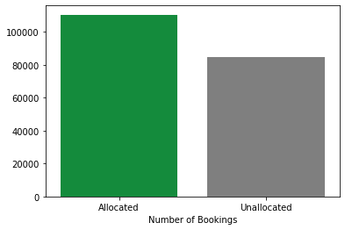
Exploratory data analysis
Distribution of Allocated and Unallocated in the dataset
DATASET IS BALANCED
57% allocated rides and
43% unallocated rides

Slide 6
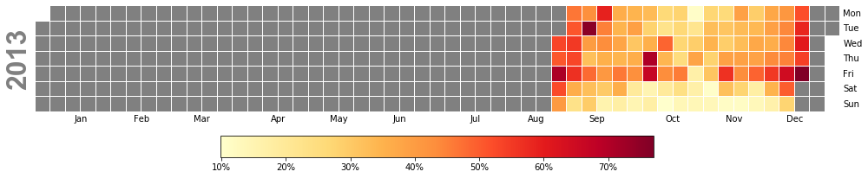
Exploratory data analysis
Calendar Heatmap of Unallocated Rides
THERE ARE MORE UNALLOCATED RIDES DURING WEEKDAYS
%
Notes:
Specifically during Friday

Slide 7
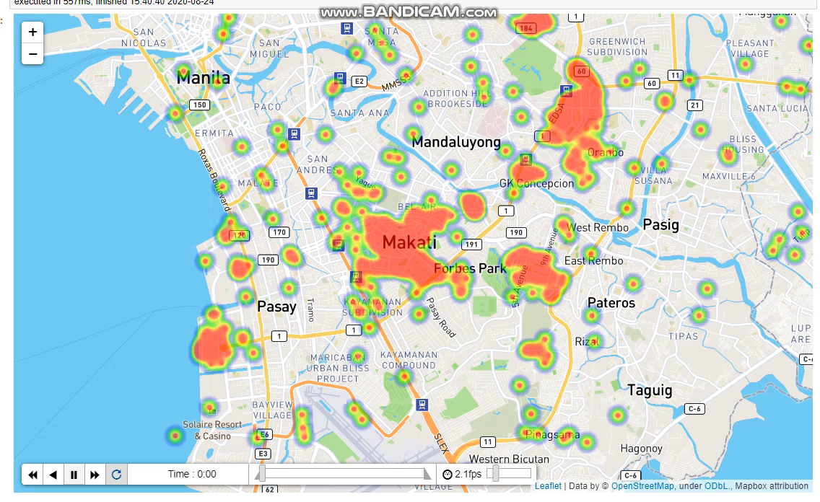
Exploratory data analysis
WHERE AND WHEN ?
THE UNALLOCATED RIDES START TO PEAK AT 7 – 9 AM THEN AT 3 PM ONWARDS NOTABLY IN BUSINESS DISTRICTS
%

Slide 8
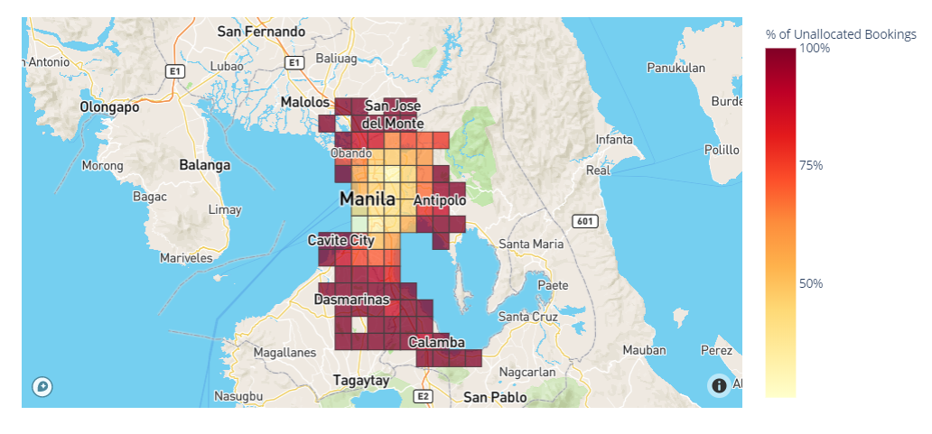
Exploratory data analysis
Heatmap of Unallocated Bookings (Pick-Up Geohash, precision = 5)
Pick-up points outside Metro Manila tend to unallocated
%

Slide 9
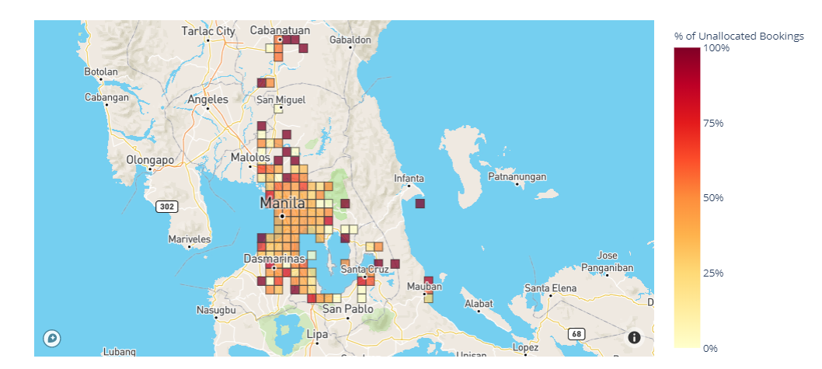
Exploratory data analysis
Heatmap of Unallocated Bookings (Drop-Off Geohash, precision = 5)
Consistently, drop-off points outside Metro Manila tend to unallocated
%

Slide 10




Features used
TEMPORAL DATA
Hour
Month
Day
Day of Week
SPATIAL DATA
Pick Up Geohash
Drop Off Geohash
Location w/in MM
%
Notes:
Mostly categorical except for trip distance, so I one hot encoded these features

Slide 11



Model Results
63%
68%
LightGBM
Baseline
1.25*PCC
Test Accuracy
Algorithm
TOP FEATURES*
hour_18
day_of_week_Friday
day_of_week_Sunday
*Based on Gain
Notes:
I was able to achieve 68% test accuracy, which is above 63% of the baseline (1.25*PCC)
I achived this using LightGBM
I explored other models such as GBM, Xgboost but LightGBM was way more efficient, I was able to train a model under a minute vs GBM and XGboost
If “split”, result contains numbers of times the feature is used in a model. If “gain”, result contains total gains of splits which use the feature.

Slide 12
Business value
Passengers can use the system to be able to plan ahead and check if their bookings will likely be allocated or not based on date, time, pick up location, and drop off location
Grab can use the findings from this study to be able to better implement their demand-capacity planning
Local Government Units can use insights from this study to push for localized initiatives that can provide better transportation system than the current options

Slide 13
recommendation
DATA
- More recent dataset
Additional features such as data for weather, holidays, amenities nearby, etc.
Use a more precise geohash or use clustering
STUDY
- Explore other ML models
- Classify whether an allocated ride is completed or cancelled

Slide 14
Thank you!

Slide 15
Questions?

